Slide 1

CUSTOMER SEGMENTATION FINAL PRESENTATION
Atul Virendra Poddar
Mechanical Engineering – 170909178
Guide : Prof. Vinyas

Slide 2
AGENDA
Quick Recap
Correlation and VIF analysis
Solution Design
Algorithms Implemented
Model Winner
Business Impact
*Variable Inflation Factor

Slide 3





PROBLEM STATEMENT - RECAP
The credit card business (X) of a big conglomerate is interested in capitalizing untapped acquisition potential within its movie customer base (Y)
Problem at hand:
How to identify and acquire profitable customers for X from Y ?
CONGLOMERATE
Analytics Problem
To understand the behaviour of customers who use X credit cards for payments at VOX cinemas
To identify profitable customers who will purchase X credit cards
Analytics Outcome
Characteristics or factors with which a customer can be deemed profitable
Framework to identify profitable customers to target for X credit cards
Customers of Interest
Customers who use X credit cards for payments at Y Cinemas

Slide 4














OUR PROCESS - RECAP
Factor Mapping
Brainstormed possible factors
Framed hypotheses
Factor Mapping
Data Understanding
Data Understanding
Created data dictionary
Summarized dataset
Data Cleaning
Preliminary preprocessing
Data Cleaning
Univariate Analysis
Understanding data variables
Outlier identification
Imputed missing values
Univariate Analysis
Imputation
Bivariate Analysis
Relationship b/w. data variables
Validating hypotheses
Bivariate Analysis
Correlation/ VIF*
Generated correlation matrix
VIF iterations
Correlation / VIF
Final Features to be fed in the model
*Variable Inflation Factor

Slide 5





PROJECT LIFECYCLE
Data Cleaning
Transforming raw data to clean data
Model Building
Building and evaluating various classification models
Business Understanding
Importance of identifying profitable customers
Exploratory Data Analysis
Understanding the variables that affect profitability
Model
Winner
Choosing the best model that can classify the customers

Slide 6
SOLUTION DESIGN

Slide 7








SOLUTION OVERVIEW FOR CROSS-SELLING X CREDIT CARDS TO Y CUSTOMER BASE
Predicted Profitable
Customers for X
1
Target this crowd with acquisition campaigns
Predicted Non-Profitable Customers for X
Transactional Data of
Y Customers
Binary Classifier
0

Slide 8
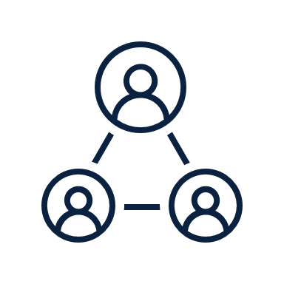


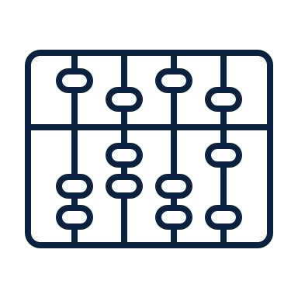
LEVERAGING THE EXISTING X CUSTOMER BASE AT Y FOR OUR ANALYSIS
Existing customers are split based on Profitability criteria provided by X Cards*
Revenue > = AED 350
Analyze the
Characteristics of Profitability
~23 out of 100
Customers are Profitable
Revenue < AED 350
Transactional Data of
X Customers
visiting Y cinemas
Final Feature Selection
*X Credit Cards called out their Profitable Customers to be generating an overall revenue of >= AED 350

Slide 9
CORRELATION & VIF ANALYSIS

Slide 10
USING VIF AND CORRELATION TO SELECT FEATURES
Removing data variables with a very high VIF >10 or correlation coefficient > 0.85 and iterating until we get satisfactory results
Sno | Features | VIF value
1 | Last_60_days | 22,687.12
2 | Last_30_days | 11,493.22
3 | Last_90_days | 11,222.60
4 | Overall_Ticket_Amt | 3,524.94
5 | Booked_Amt | 2,908.54
6 | Overall_Spend | 606.21
7 | #Tickets | 545.11
8 | Pref_cinema_experience_#Ticket | 454.55
9 | Booked_Rdmption | 111.43
10 | Pref_movie_country_name_Spend | 76.22
11 | Pref_transaction_channel_Spend | 46.64
12 | Pref_transaction_channel_#Ticket | 45.90
13 | Pref_cinema_experience_Spend | 43.99
14 | #Movies_Watched | 41.63
15 | #Unique_Movies | 41.21
16 | Tickets_Weekend | 40.80
17 | Pref_movie_country_name_#Ticket | 40.65
Sno | Features | VIF value
18 | Pref_genre_name_Spend | 27.75
19 | #Weekends | 24.75
20 | Pref_film_rating_#Ticket | 19.90
21 | Pref_cinema_location_#Ticket | 19.28
22 | Pref_genre_name_#Ticket | 18.08
23 | Pref_cinema_location_Spend | 14.281
24 | Avg.Movie_Dur | 8.87
25 | Pref_film_rating_Spend | 7.22
26 | Avg_Tickt_Cost | 5.79
27 | Overall_FB_Spent | 5.35
28 | Is_internet_flag | 3.63
29 | Is_Action_flag | 2.75
30 | Is_mobile_flag | 2.60
31 | Is_Hollywood_flag | 2.07
32 | REVENUE_NAJM | 1.70
33 | New_Customer | 1.52
34 | Avg_Booking_Time | 1.39
First Iteration
Citing Katrutsa and Strijov (2017) & Curto and Pinto (2011)

Slide 11





RELEVANT FEATURES WERE SELECTED AFTER FEATURE GENERATION
Final List of Features
# of Tickets bought on Weekends
Booking Amount
Booking Redemption
Average Movie Duration
Average Ticket Cost
Transaction Channel (Internet Ticketing)
Transaction Channel (Mobile Phone)
Watched an action movie or not
Watched a Hollywood movie or not
Amount spent on preferred cinema location
Amount spent on preferred film rating
Amount spent on preferred cinema experience
Amount spent on Food & Beverages
# of Unique Movies Watched
# of Visits in Last 90 days
Average time taken to make a booking
# of Tickets bought on Weekdays
Average Spend per Visit
Customer Tenure
53
Variables
Univariate Analysis
Bivariate Analysis
Correlation
VIF*
19
Features
16 Features were selected from an exhaustive list of 53 variables through analysis
3 New Features were created from the existing features:
Customer Tenure, Average Spend per Visit, # of Tickets bought on Weekends

Slide 12


WORKFLOW EMPLOYED TO ACHIEVE THE DESIRED OUTCOME
Data
Preparation
Feature Engineering
Data cleaning
Imputation
EDA
Outlier Treatment
Correlation
VIF
Feature Generation
Feature Scaling

Slide 13







WORKFLOW EMPLOYED TO ACHIEVE THE DESIRED OUTCOME
Iterative Model Updating
Evaluate
Data
Preparation
Feature Engineering
Build Classification Models
Monitor
Compare
Data cleaning
Imputation
EDA
Outlier Treatment
Correlation
VIF
Feature Generation
Feature Scaling
Logistic Regression
Naïve Bayes
K-Nearest Neighbors
Random Forest
Rebuild
Deploy best performing model

Slide 14
RELEVANT MODELS FOR OUR PROBLEM STATEMENT - RECAP
 | K –Nearest Neighbours | Logistic Regression | Support Vector Machine | Decision Tree | Boosting Techniques | Random Forest
Outliers | SENSITIVE | SENSITIVE | ROBUST | ROBUST | SENSITIVE | ROBUST
Collinearity | SENSITIVE | SENSITIVE | SENSITIVE | ROBUST | ROBUST | ROBUST
Performance | LOW | LOW | MEDIUM | MEDIUM | HIGH | HIGH
As our dataset contains a high number of features, one decision tree cannot perform well and give accurate predictions
The decision tree might overfit the training data, if the parameters are not well tuned
This can be overcome if we use ensemble learning methods, like Random forest & Boosting because it will build N number of decision trees and give the outcome based on polling
Random forest and boosting is a combination of many decision trees thus, more robust than a single decision tree
Random Forest can be best suited for our dataset as it is not sensitive to outliers

Slide 15
ALGORITHMS IMPLEMENTED
Logistic Regression
Naïve Bayes
K-Nearest Neighbours
Random Forest

Slide 16
METRICS USED FOR MODEL EVALUATION
Area Under Curve - AUC
(Area under ROC* curve)
How good the classifier is at distinguishing between the profitable and non-profitable customers
Recall
(Capture Rate)
Fraction of customers which are correctly identified as profitable out of all actual profitable customers
Precision
(Conversion Rate)
Fraction of customers who turn out to be profitable among all the predicted profitable customers
Recall is low ⇒ Model will classify profitable customers as non-profitable
Precision is low ⇒ Model will classify non-profitable customers as profitable
“ The cost of lower recall is way higher than the cost of lower precision”
(As per business requirements)
Why Accuracy is not our evaluation metric?
Not a good measure of classifier performance for highly imbalanced dataset
(In our case, distribution of majority-to-minority class is 77:23, then labelling all data points as majority class would give you 77% accuracy which is really good score, but in fact the model has not learned anything)
*Receiver Operating Characteristics
Citing Wasikowski and Chen (2010)

Slide 17
MODEL PERFORMANCE RESULTS
Model | AUC | Recall | Precision | Threshold
Logistic Regression | 55% | 69% | 27% | 23%
Naïve Bayes | 54% | 65% | 27% | 4%
K-Nearest Neighbors | 54% | 80% | 26% | 19%
Random Forest | 58% | 78% | 28% | 43%
Notes:
AUC score
Recall
We are treating outliers and manipulating data which is not in case of random forest

Slide 18


LOGISTIC REGRESSION AND NAÏVE BAYES ARE NOT SUITED FOR OUR PROBLEM
Model | AUC | Recall | Precision | Threshold
Logistic Regression | 55% | 69% | 27% | 23%
Naïve Bayes | 54% | 65% | 27% | 4%
K-Nearest Neighbors | 54% | 80% | 26% | 19%
Random Forest | 58% | 78% | 28% | 43%
Sensitive to Outliers
Outlier Treatment is required for good model performance
Treating the outlier leads to losing the actual data
Lower Recall
Model would miss out on the actual profitable customers

Slide 19
KNN IS THE CHALLENGER MODEL
Model | AUC | Recall | Precision | Threshold
Logistic Regression | 55% | 69% | 27% | 23%
Naïve Bayes | 54% | 65% | 27% | 4%
K-Nearest Neighbors | 54% | 80% | 26% | 19%
Random Forest | 58% | 78% | 28% | 43%
KNN vs Random Forest
KNN has a recall of 80% while Random Forest has 78%
Comparing the AUC scores, Random Forest is higher with a score of 58% while KNN has 54%
Results might be inflated for KNN model since we used KNN Imputer for imputing

Slide 20
KNN IS THE CHALLENGER MODEL
Model | AUC | Recall | Precision | Threshold
Logistic Regression | 55% | 69% | 27% | 23%
Naïve Bayes | 54% | 65% | 27% | 4%
K-Nearest Neighbors | 54% | 80% | 26% | 19%
Random Forest | 58% | 78% | 28% | 43%
KNN vs Random Forest
KNN has a recall of 80% while Random Forest has 78%
Comparing the AUC scores, Random Forest is higher with a score of 58% while KNN has 54%
Results might be inflated for KNN model since we used KNN Imputer for imputing
We trade-off 2% decrease of the recall for a 4% increase in AUC score

Slide 21

RANDOM FOREST WAS SELECTED AS THE CHAMPION MODEL BASED ON MULTIPLE ITERATIONS
Actual
58%
Confusion Matrix
for Test Data
AUC Score
 | Profitable | Not Profitable
Profitable | 861 | 2,130
Not Profitable | 237 | 1,270
78%
Recall
Predicted
Probability Threshold: 43%
Not Overfitted
The difference between training and testing metrics is negligible
High Recall
signifies that it is better at predicting actual profitable customers
High AUC Score
signifies the model is better at distinguishing between profitable and non-profitable customers

Slide 22
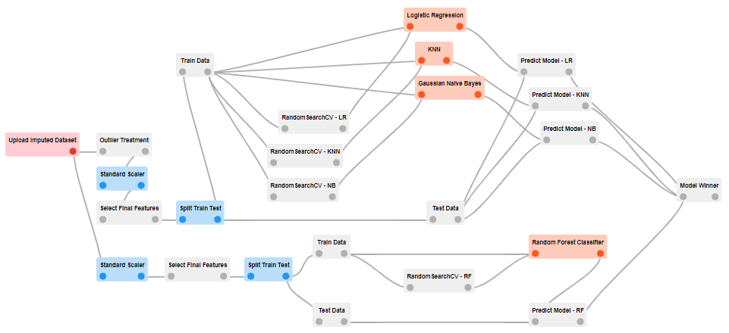

CO.DX BLUEPRINT FOR MODELLING
Modify threshold and generate classification metrics
Select the best performing model
Upload the dataset obtained after pre-processing steps
Remove duplicate columns generated after applying Standard Scaler

Slide 23
BUSINESS IMPACT

Slide 24






BUSINESS IMPACT
Understand and leverage the existing customer base
Framework for identifying profitable customers to target
Cross selling NAJM credit cards to other business units
Conventional
Marketing
Data-Driven Marketing
The model manages to capture 78% of the profitable customers which is our target segment
Reduction in marketing cost and increase in ROI*
Tailoring acquisition campaigns for profitable customers
*ROI – Return on Investment

Slide 25
NEXT STEPS
Fine tuning the Model results(increase capture and conversion rate)
Getting new data features from the client – Frequency of visiting, Cancellation, Offers provided
Generate other possible features from the existing features
Enhance Model Performance
Build a framework to score customers’ propensity
Marketing materials and campaigns can be tailored to individuals based on their estimated propensity to purchase
Propensity Model
Tool which recommends acquisition strategies tailored specifically for a customer
Tool for Marketing Team

Slide 26
THANK YOU

Slide 27
APPENDIX

Slide 28

CUSTOMERS SPENDING MORE THAN AED 120 PER VISIT ARE PROFITABLE
Event Rate = 23.14%
Observations:
As average spend per visit increases, profitability increases
Customers spending more than AED 243 are highly profitable
Notes:
These genre movies are screened in premium experience like IMAX, 4DX where the standard tickets cost around AED 80

Slide 29
CUSTOMERS WITH A TENURE OF 10 MONTHS AND MORE ARE PROFITABLE
Event Rate = 23.14%
Observations:
Spikes in profitability is observed when the customer tenure is between 15-19 & 30-34 months
Profitability flattens as a customer approaches two years of tenure but increases again as it approaches the third year
Notes:
These genre movies are screened in premium experience like IMAX, 4DX where the standard tickets cost around AED 80

Slide 30
PROFITABILITY DECREASES, AS NUMBER OF TICKETS BOUGHT ON WEEKDAY INCREASES
Event Rate = 23.14%
Observations:
~18% people buy up to 1 ticket on weekdays
People buying only 2 tickets during weekdays are highly profitable
Notes:
These genre movies are screened in premium experience like IMAX, 4DX where the standard tickets cost around AED 80

Slide 31
RELEVANT MODELS FOR OUR PROBLEM STATEMENT
 | K –Nearest Neighbours | Logistic Regression | Support Vector Machine | Decision Tree | Boosting Techniques | Random Forest
Outliers | SENSITIVE | SENSITIVE | ROBUST | ROBUST | SENSITIVE | ROBUST
Collinearity | SENSITIVE | SENSITIVE | SENSITIVE | ROBUST | ROBUST | ROBUST
Performance | LOW | LOW | MEDIUM | MEDIUM | HIGH | HIGH
As our dataset contains a high number of features, one decision tree cannot perform well and give accurate predictions
The decision tree might overfit the training data, if the parameters are not well tuned
This can be overcome if we use ensemble learning methods, like Random forest & Boosting because it will build N number of decision trees and give the outcome based on polling
Random forest and boosting is a combination of many decision trees thus, more robust than a single decision tree
Random Forest can be best suited for our dataset as it is not sensitive to outliers

Slide 32










ARCHITECTURE DIAGRAM
Client
Raw Data
Prediction Modelling
Azure Storage
Blob
Data quality check module
Data Cleaning Module
Analytical
Dataset
Azure Storage
Blob
Model Results
Azure ML
Exploratory Data Analysis
EDA Module
Plotting Graphs
EDA Results
Dashboard
Client

Slide 33






ARCHITECTURE DIAGRAM USING AIRFLOW
Data Pipeline, Orchestration and Monitoring
Raw Data
Data Pre-processing and
Feature Engineering
Web Application
ML Models and
Model Results
Azure Storage
Blob
Azure Storage
Blob
Data Quality Check
EDA
Version Control

Slide 34
FEATURE IMPORTANCE
Feature | Importance
Avg.Movie_Dur | 0.100
Booked_Rdmption | 0.098
Spend_per_movie | 0.093
Avg_Booking_Time | 0.090
Avg_Tickt_Cost | 0.087
Customer_Tenure | 0.067
Booked_Amt | 0.066
Pref_film_rating_Spend | 0.062
Pref_cinema_location_Spend | 0.062
Pref_cinema_experience_Spend | 0.061
#Weekday_Tickets | 0.050
#Unique_Movies | 0.034
Last_90_days | 0.031
#Weekends | 0.028
Overall_FB_Spent | 0.023
Is_Hollywood_flag | 0.019
Is_Action_flag | 0.011
Is_internet_flag | 0.011
Is_mobile_flag | 0.007

